Slide 1
Session 1- Advanced Excel Masterclass
Power Pivot For Excel and Financial Analysis

Slide 2
Objectives
By the end of this practical you will be able to:
Create a data model
Differentiate between dimension and fact tables
Use DAX “Data analysis expressions”
Utilise PowerPivot to create relevant reports and dashboards
Work on Financial reporting example – create an income statement.

Slide 3
How to add PowerPivot tab to Excel ribbons?

Slide 4
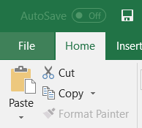
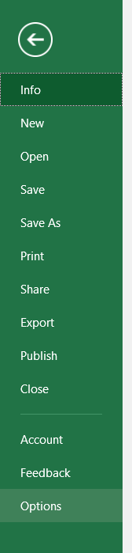
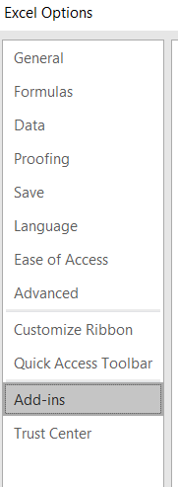
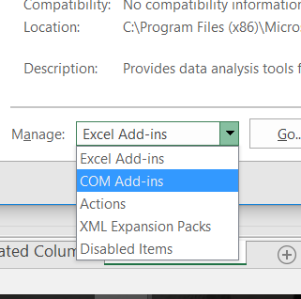
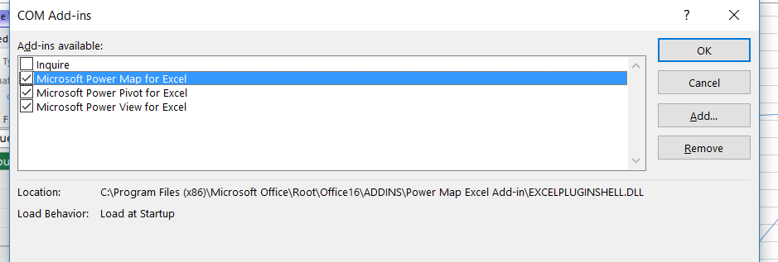
4- Select COM Add-ins and click GO
1- Click File tab
3- Select Add-in
Before you start you need to add POWER PIVOT FOR EXCEL to your ribbon. Follow screenshots order to get the relevant tab.
2- Select options
5-Tick Microsoft Power Pivot and click ok

Slide 5
What is PowerPivot? (1/3)
Report Building System that has these benefits above and beyond Normal Excel:
1) PowerPivot uses the PivotTable User Interface
2) PowerPivot uses an in memory Columnar Database that allows large data sets and fast formula calculating speed.
3) Can handle very large data sets (Safely handles 100 Million rows)
4) When you have non-normalized data and you are worried about file size. Import into PowerPivot to reduce file size.
5) Faster calculation than large array formula equivalents.

Slide 6
What is PowerPivot? (2/3)
6) Allows you to pull data from more than one table into one report using Relationships rather than VLOOKUP.
**If you have a small data set with multiple tables in Excel, it may be easier to just have helper columns with VLOOKUPS.
7) Can connect to multiple different external datasets that can be refreshed with a single click (Ctrl + Alt + F5)
8) DAX Formula language dramatically increases the formula possibilities in a PivotTable (CALCULATE (the do anything function), COUNTUNIQUE, TOTALYTD)

Slide 7
What is PowerPivot (3/3)
9) DAX “Data Analysis Expressions” formulas allow you to build formulas and add Number Format in one place, then use it in any PivotTable you want.
10) Convert PivotTable to Cube functions
11) Can import existing relationships and tables in one import session.
12) Data in Data Model is read only (secure and reliable)

Slide 8
When to NOT use PowerPivot?
Millions of Excel users everyday have Excel tasks that do not involve large datasets from multiple sources
  Payroll
  Cash Flow Analysis
  Depreciation table.
  On the fly calculations.
If you have a small data set with multiple tables in Excel, it may be easier to just have helper columns with VLOOKUPS. The time and effort to use PowerPivot to replace a number of VLOOKUPS, may not be worth it.
When you don’t have big data.

Slide 9
When to use PowerPivot?
You can use PowerPivot if you want:
1) PivotTable user interface Reporting System
2) Big Data from Multiple Sources: In PowerPivot can reduce file size and decrease formula calculation time.
3) Increase formula language, and Portable Formulas

Slide 10
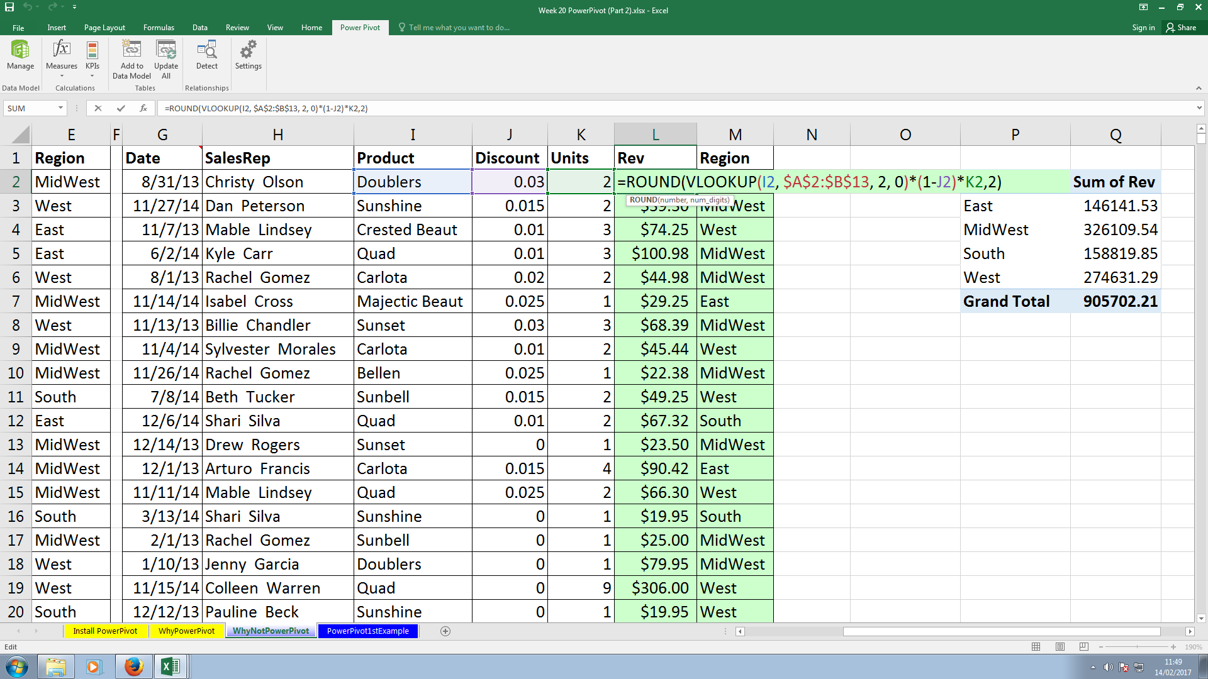
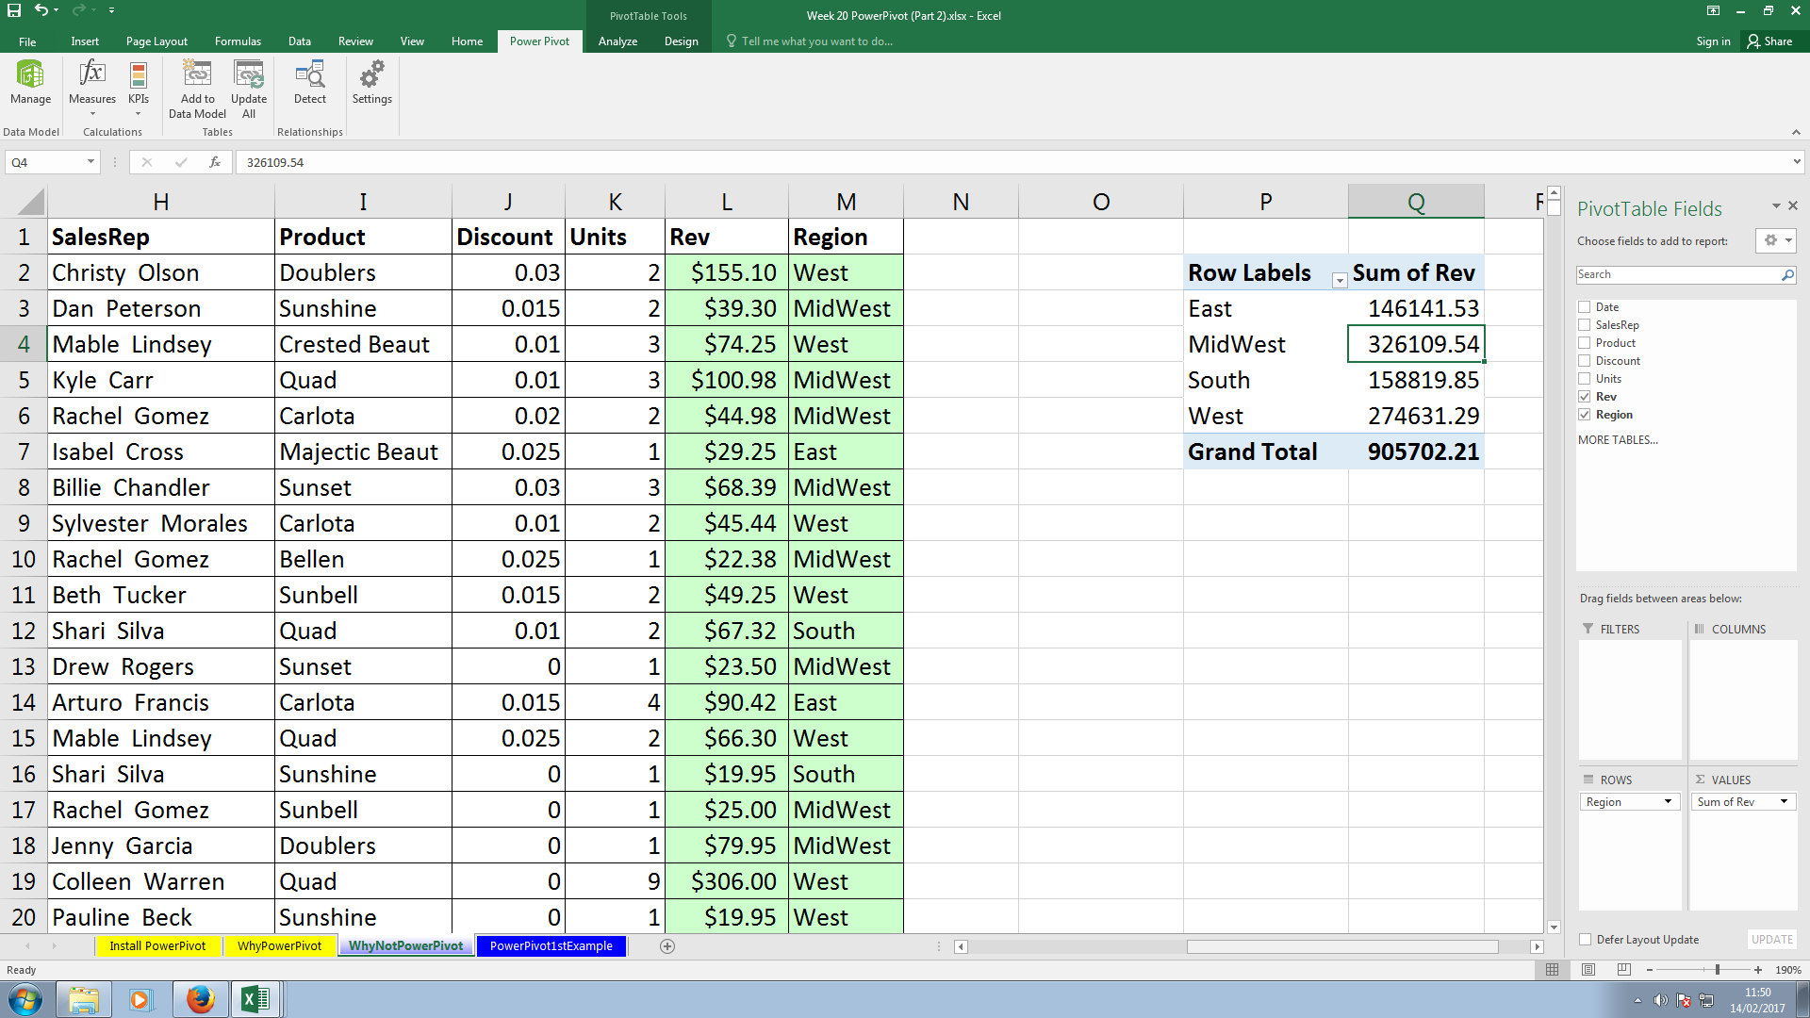
Try to get total net revenues per region using VLOOKUP

Slide 11
What do you conclude?
The previous step is similar to what Power Pivot does but it is limited to just getting one new column “Net Revenue” for each Region.
PowerPivot offers speed, automation and flexibility in creating your own measures (new functions)!

Slide 12
How to build a data model using tables in Excel workbook
1- Convert static tables to dynamic tables and name them.
  Select table and click CTRL+T
  Name tables: dProduct, dSalesrep, Ftransaction
2. “d” stands for dimension table and “F” stands for Fact table.
These terms are use in data science and when building databases.
  Dimension “unique” table: contains unique (unrepeated) values. Example: list of products or sales reps.
  Fact table: contains records with repeated values.

Slide 13
A fact table
This could be, for example, a full set of financial transactions, sales invoices, timesheet entries. This is basically the dataset that you’re looking to analyse.
This table will normally have numeric values on each record, such as an invoice value or recorded hours, but it doesn’t have to include a numeric value. You could be analysing survey data which may be text records and you might want to count the number of responses that fit a certain criteria.

Slide 14
Dimension tables
You could have one or many of these tables. These provide extra information about the records in your fact table.
For example, your fact table records may include a date for the transaction. That date inherently has may other attributes such as month, quarter, year, fiscal period, day of week and many other attributes. These attributes don’t need to be repeated on each record in your fact table. You can simply hold those attributes in a dimension table.

Slide 15
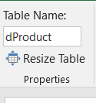
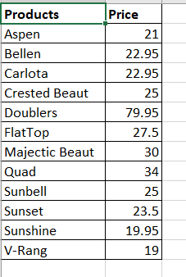
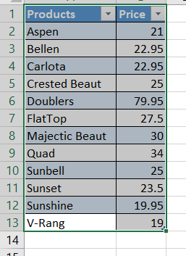
2- Name each dynamic table
3- Do the same for all tables:
dSalesrep
FTransaction
Static table
1- Convert to Dynamic table

Slide 16
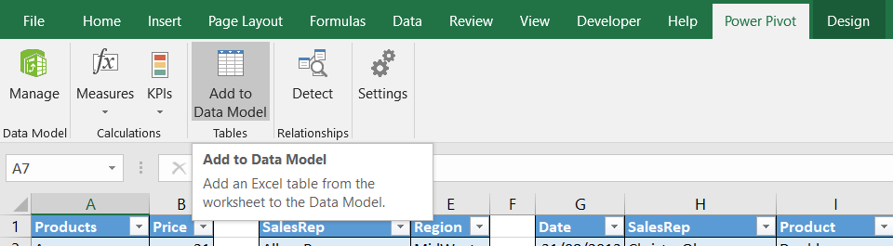
Add the three tables to Data Model
Stand on any cell in dProduct table and click on add to data model. Wait few second until you see the window in the next slide. Do the same for the other two tables

Slide 17
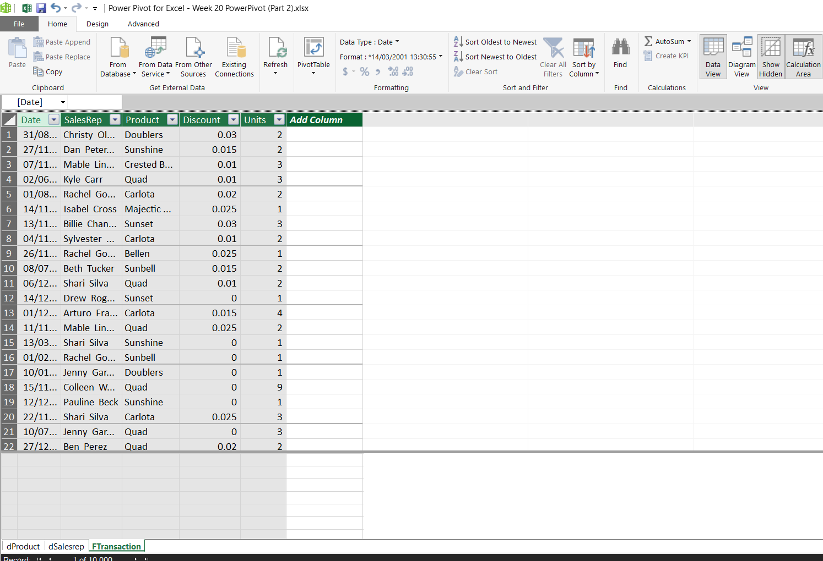
Now we are in data view
You need to format every column to set up your data model

Slide 18
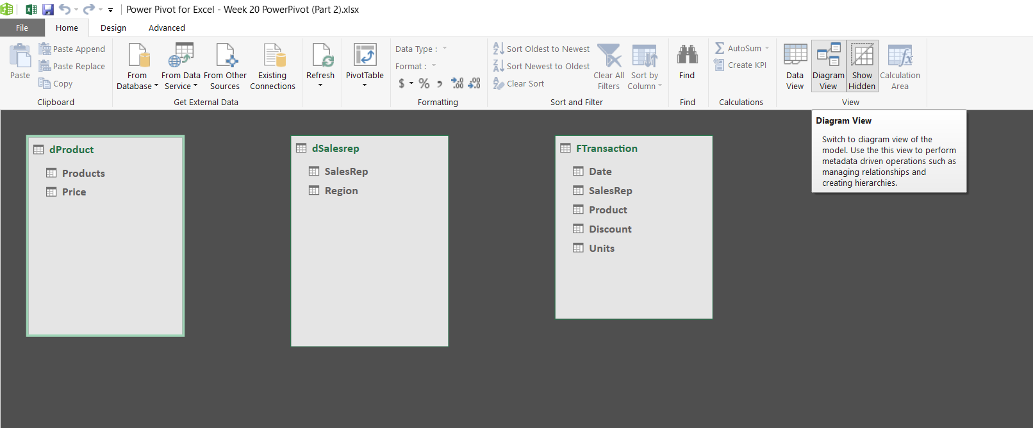
This is diagram view, where each table contains fields which you can create relationships between them

Slide 19
How to create Relationships between tables?
This table has unique values
This table has unique values
In order to be able to make FTransaction table inherit the prices of the products, drag “Products” field from “dProduct” Table and drop at “Product” in FTransaction
Follow your tutor’s explanation for easier application ☺

Slide 20
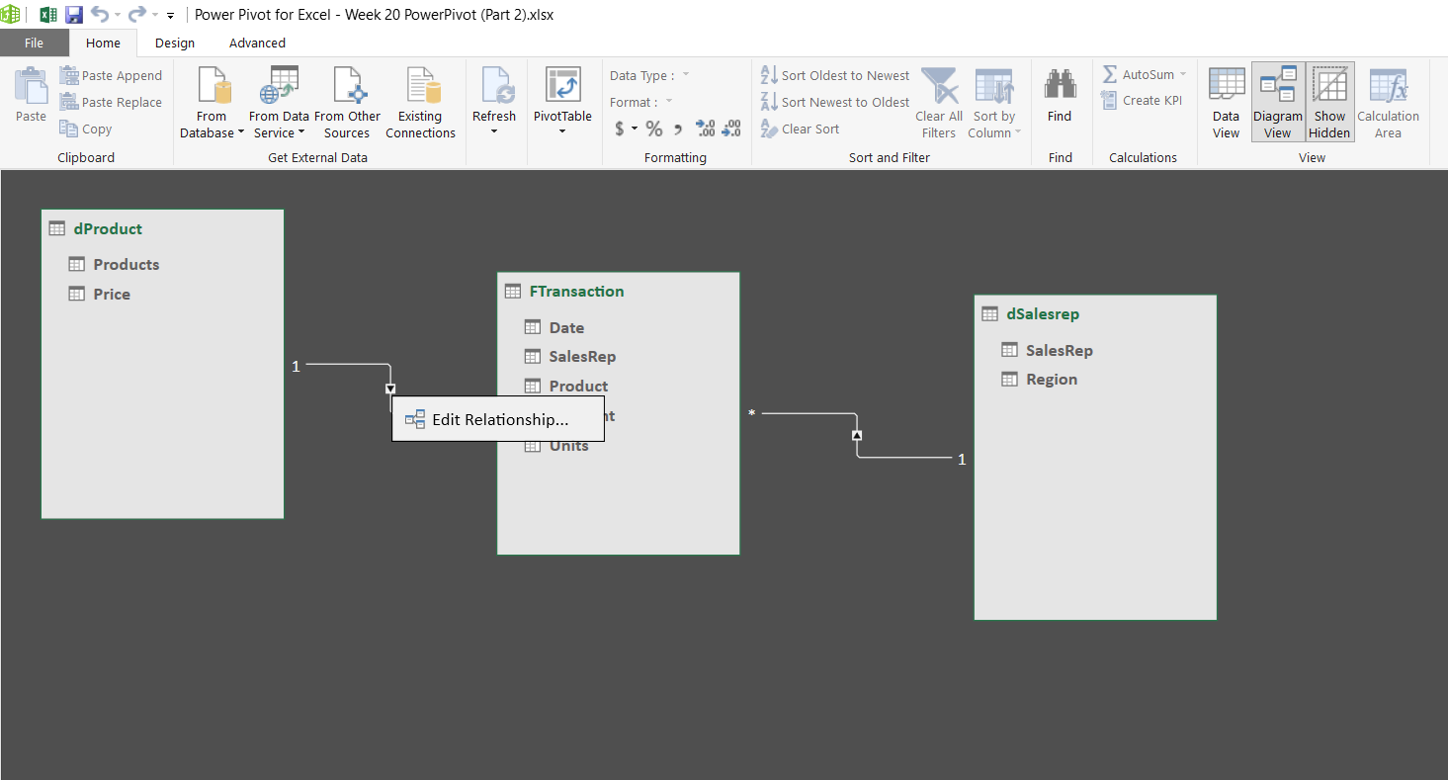
This is called one (1) to many (*) relationship
You can edit relationships “make it inactive by right clicking this square

Slide 21
Let’s get back to data view

Slide 22
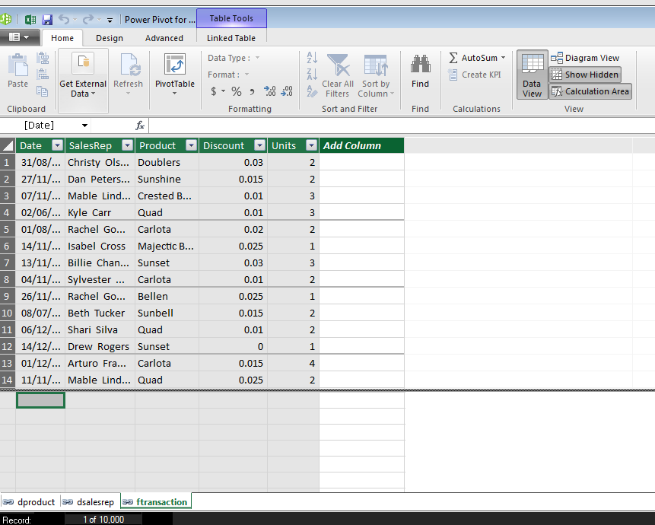
To create relationships between fields
This area is called
data Grid where you can
create Calculated Columns
This area is called
Measure grid where you
can create calculated fields

Slide 23
What is a Calculated Column
In a Calculated Column, CALCULATE can make Context Transition and show individual amounts or amounts calculated through a relationship rather than the actual aggregate amount.
+ 0 can show a zero rather than a null when the database is filtered down to no records.

Slide 24
Why we need a Calculated Column?
Can be used as Row/Column/Filter/Slicer Values. Also in Calculated Fields.
Create new Fields like "Month" from Serial Number Dates.
Calculate at the Row Level, Row-by-Row, "Row Context"
Context: Row in PowerPivot TABLE

Slide 25
Get the following calculated column

Slide 26
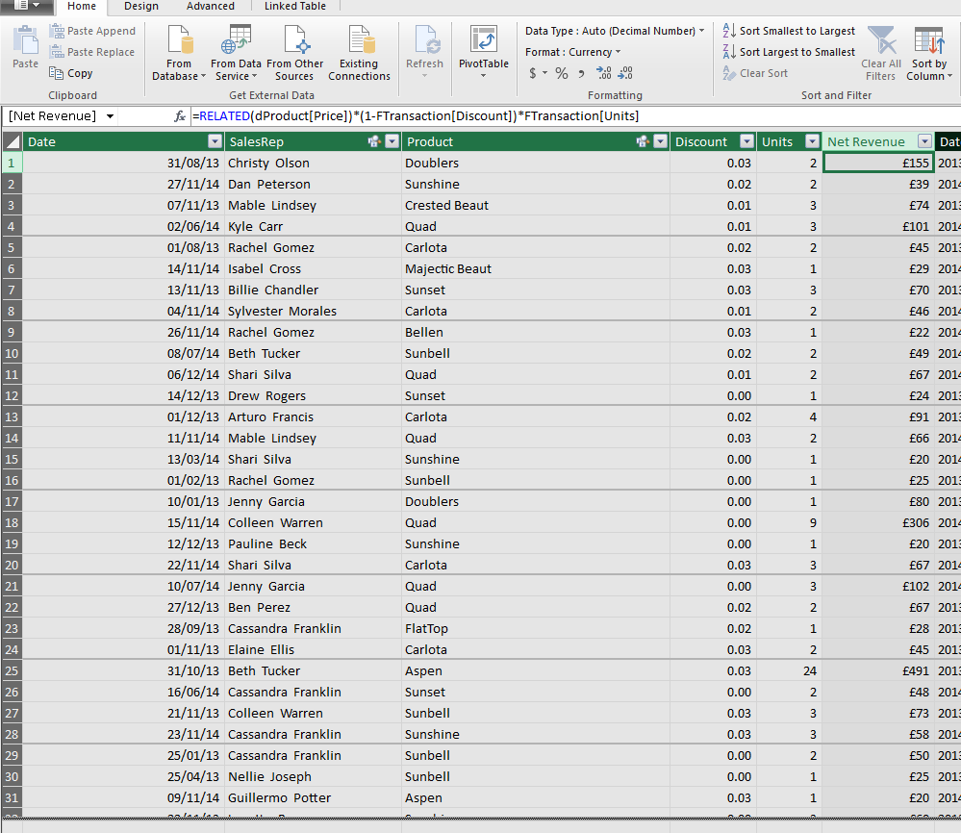
Calculated column
The RELATED function requires that a relationship exists between the current table and the table with related information. You specify the column that contains the data that you want, and the function follows an existing many-to-one relationship to fetch the value from the specified column in the related table.

Slide 27
Format calculated column to show £ and whole number

Slide 28
What is a Calculated Field “Measure”?
Can only be used in Values area of PivotTable.
These are the "Portable Formulas" that can:
1) Be used many times in other PivotTables and other Calculated Fields.
2) Number Format only Once.
3) Understand Relationships
4) Easy to edit
5) More Functions than PivotTable.

Slide 29
What is a Calculated Field “Measure”?
Calculate at the Aggregate Level, "Filter Context" Applies.
Context: PivotTable Cell
Calculates when PivotTable is Pivoted, and when created.
Always use tables names and field names, except when using Calculated Fields in other Calculated Fields, then just use square brackets.
Process:
  Filters/Criteria from PT and formula are applied to source tables,
  Data Model Columnar Database is Filtered,
  Calculations is made on Filtered database.
+ 0 can show a zero rather than a null when the database is filterd down to no records.

Slide 30
Why we need a Calculated Field “Measure”?
If you have the choice between drag and drop to SUM in a Pivot (called implicit formula) and making a Calculated Field with SUM function (called Explicit formula), it is better to use explicit because:
It is ready for use
It is formatted
It is tailored to a specific value you want for reporting

Slide 31
Get the following calculated field

Slide 32
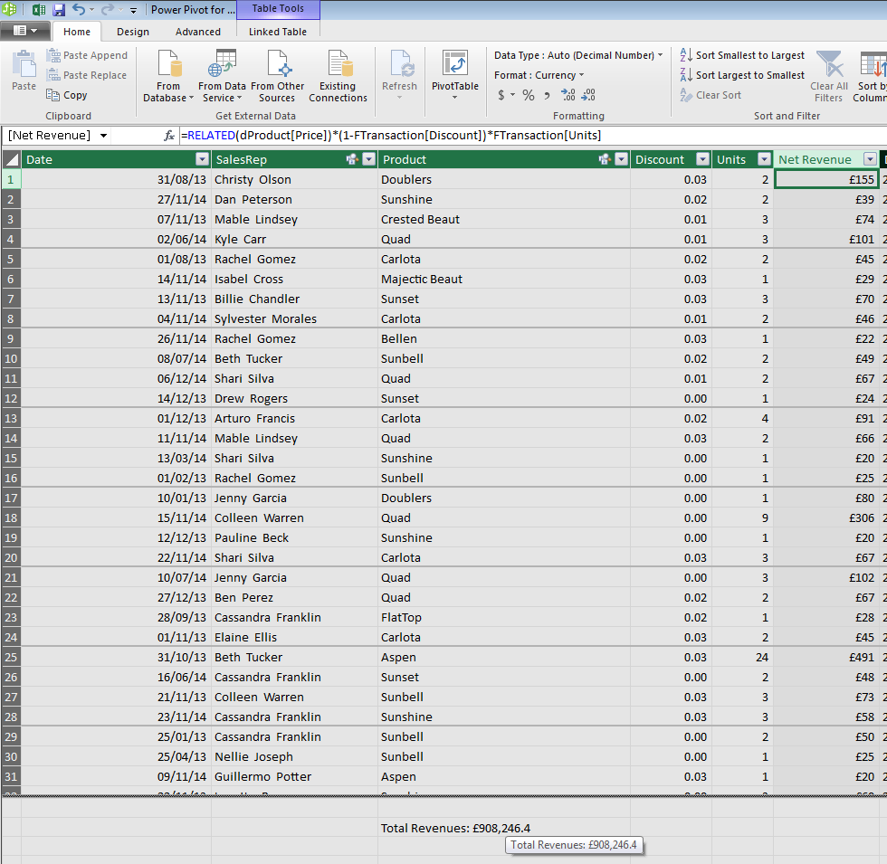
Calculated Field

Slide 33
Format calculated field to show £ an whole number

Slide 34
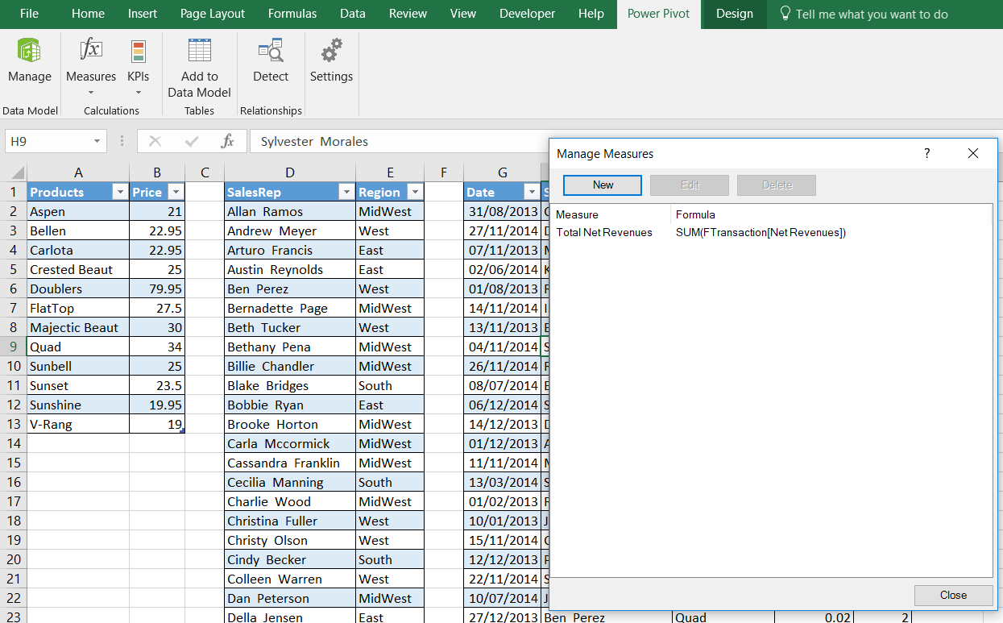
You can find any measures created here

Slide 35
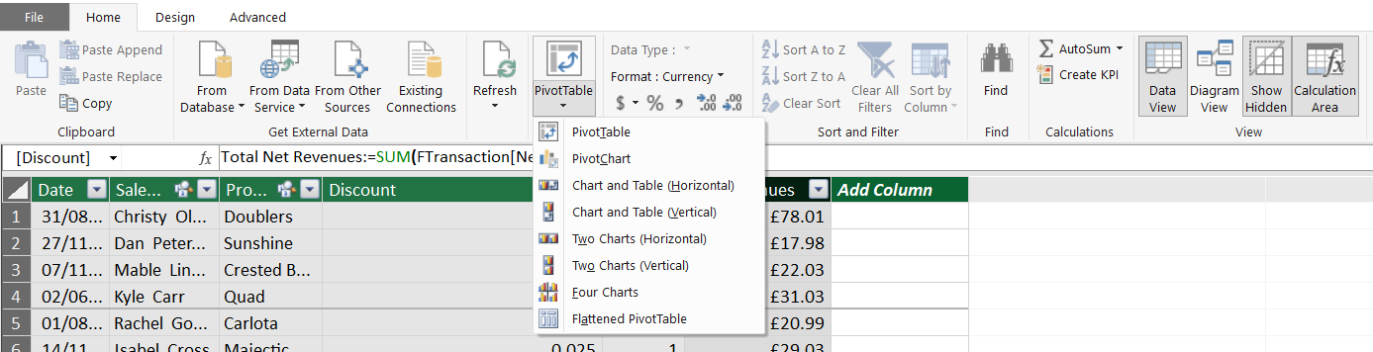
Save and Get the following pivot tables and charts using the data model you created.

Slide 36
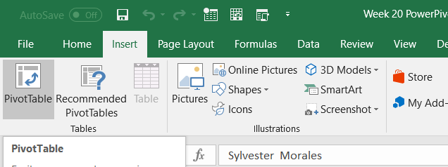
Or you can get pivot tables from here:

Slide 37
Pivot tables/charts required:
PT1: Total units per region
PT2: Total Net Revenues per product
Conditionally format total net revenues to show Green Bar to all cells showing Sum Net Revenues values for product
Chart 1: based on PT2, insert horizontal bar chart to show total net revenues per product every year. Automate its title to show year. Hint: insert date “showing Year as a filter in a new pivot table”
PT3: Total Net Revenues per region
Chart 2: based on PT3, insert 3D clustered bar chart and automate its title to show year.
Insert a slicer for Date (year)
Create a Dashboard

Slide 38
My Website:
https://drsamargad.wixsite.com/sgad/training

